Slide 1
Introduction to lfd testing in workplaces
Overview of approach
11 January 2021

Slide 2
Setting up a test service for your employees will require the following six steps
ENGAGE EMPLOYEES
SET UP TEST SITE & TRAIN STAFF
ORDER TEST KITS & PREPARE FOR TESTING
CONDUCT TESTING
TEST SAMPLE ANALYSIS
RESULT NOTIFICATION & FOLLOW UP
Inform your Employees of your test site and its purpose, share related materials with them, explain the testing process and ask them to provide consent to participate in testing
Fill out the Order Form to organise test kit delivery in advance
Sign the Schedule to agree to the Terms
Communicate booking slots to your employees
The collected samples are processed and analysed on site in the allocated area, results will be determined on the day
Procure services and materials described in the Guidebook
Identify the space for your test site and set up according to the Guidebook
Mobilise staff to perform Test Operative roles, and organise your employees for testing
Set up Sites and Test Operatives on the Results Logging Website
Begin testing employees
Your consenting employees will receive their results to the contact details they provide when they register

Slide 3
Roles and responsibilities are divided as follows:
Government-Supported Test Site Responsibilities
Organisation
NHS T&T
SET UP TEST SITE & TRAIN STAFF
Identify, construct and set up test site, and recruit workforce
Conduct site risk assessment
Guidebook with full spatial requirements (site visit for novel settings)
Supply “booths in a box” for employers to purchase if required
Online training and assessment for your test Operatives
ORDER TEST KITS & PREPARE FOR TESTING
Size population to test and plan testing throughput / scheduling;
Source PPE, cleaning materials, and other consumables
Provide and fund test kits
EMPLOYEE ENGAGEMENT
Co-brand and adapt communications materials, engage employees, and provide test-appointments process
Standard communications pack for employees and media lines, videos/posters and FAQs
CONDUCT TESTING
Employee self-registers online on their or your device;
Move employees through the site for supervised self-swab
Subject registration portal
TEST SAMPLE ANALYSIS
Operatives who process the swabs and analyse the LFD results
Device and Operative to submit results on Results Logging service
Approved clinical protocol (SOP)
Web-based Results Logging service
RESULT NOTIFICATION & FOLLOW UP
Employees notified via text or email entered during self-registration
Provide managed device to scan & record results
Subject notification through T&T
Note: subject to change, Terms and Conditions apply and must be accepted prior to receiving test kits

Slide 4
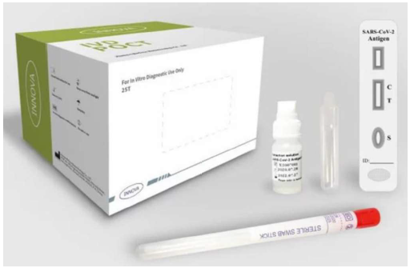











Your employees will be tested using our validated Lateral Flow Antigen tests
The LFD brand currently available in this scheme is:
Innova’s SARS-CoV-2 Antigen Rapid Qualitative Test
Test kit composition
4
1
Swab
Lateral Flow Antigen testing involves the processing of nasal and throat samples with a Lateral Flow device, highlighting a coloured strip on the device to show a positive result
2
Extraction vial
3
1
3
Extraction solution
Fast result (20-30 minutes)
Outside of a formal laboratory setting
Well-suited for frequent testing of large numbers of asymptomatic people
4
Lateral flow device
2
Innova has an overall sensitivity of 76.8% for all PCR-positive individuals but detects over 95% of individuals with high viral loads, and minimal difference between the ability of the test to pick up viral antigens in symptomatic and asymptomatic individuals
Key Facts
Manufacturer | Product Name | Test Type | Sensitivity est. | Specificity est. | Sample-to-analysis est.
Innova Tried & Tested | Innova SARS-Cov-2 Antigen test | Swab | 76.8% | 99.68% | 20 – 30 mins
1
Register & Swab
2
Process
3
Analyse
4
Log result
Negative result: Log result against test ID by scanning the barcode (individual does not have to self isolate)
Complete a self-administered throat & nasal swab test
Prepare and load (‘dropping’) the sample onto the cartridge, conduct proper extraction and wait 20-30 minutes
Analyse result against manufacturer IFU and interpret result as Negative, Positive or Invalid
Positive result: self-isolate according to national guidelines if positive
Invalid result: retest

Slide 5
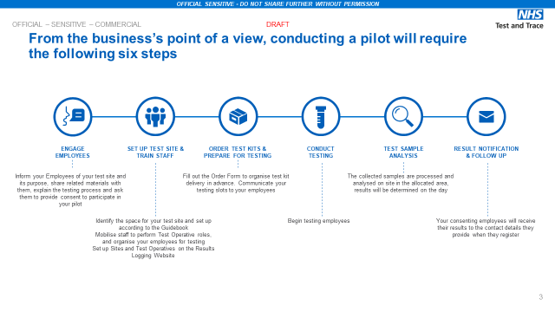

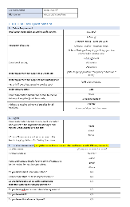
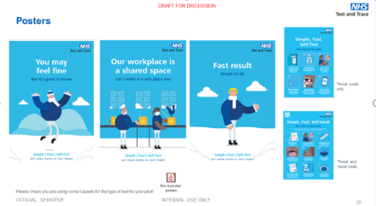
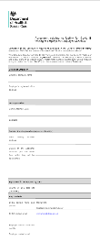
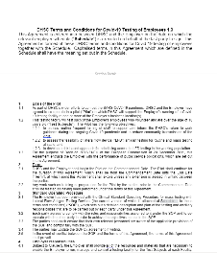
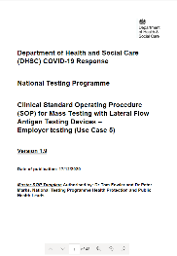
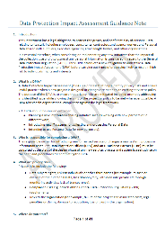
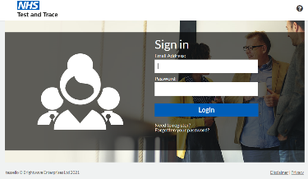
Full documentation and training is available to support you
Introduction | Guidebook | Order form | Comms pack
An overview of asymptomatic testing, including end-to-end testing process, Innova product overview, and roles and responsibilities. Share with organisation leadership. | Detailed guidance for test site setup and how to operationalise testing in accordance with the SOP. Give to Facilities/Project Manager | A form to calculate the demand for test kits and submit an order to DHSC. It is designed for us to send test kits to one site and then you do the distribution among your sites. Give to SRO/Project Manager | Provides helpful messages and materials such as FAQs, sample engagement products, technology explainer, etc. Give to HR/Comms Lead.
Standard terms and schedule | SOP | DPIA | Online training
Legal agreement with DHSC under standard terms and conditions. Give to SRO, Counsel, and Signatory | Explains the approved clinical procedure and protocol requirements to implement a safe and effective test site. Give to SRO, Counsel, and HSE/Medical Lead | Data Protection Impact Assessment Guidance explains the data flows and data protection for the digital solution. Give to SRO, Counsel/Data Privacy Lead | Self-service training and assessment for Operatives (link is in the Guidebook). Operatives receive a certificate to document successful training. Deployed by Project Manager/Trainer
Notes:
Site visits prior to setting up the test site – this will allow us to discuss any features that are unique to your site
Interviews with site managers, both before setup of the test site and once the testing is up and running – these will be as no one knows the intricacies of your site as well as your site managers
Observation of the test process – once you are set up we will observe the test process to get a view of what is working well for you and what could be improved
Exit interviews with employees – depending on the willingness and availability of your employees, these can vary from a quick rating of the service from 1-5, to a short interview
Employee surveys – if appropriate, these surveys will allow us to understand personal concerns of your employees and barriers that may prevent them getting tested

Slide 6
Each organisation agrees to accept DHSC’s Terms and Conditions which are underpinned by the following core assumptions
Policy
Commercial & Legal
Testing will not remove requirements to follow all national government guidance on COVID-safe workplaces, such as social distancing
Those who test positive will need to self isolate as per government guidelines. Close contacts will need to self isolate, unless the optional “Daily Contact Testing” protocol is implemented
The organisation will construct and set up testing environments in accordance with SOP guidelines (including storage areas for tests) for sample collection, analysis, disposal and reporting
NHS Test and Trace will fund and supply the tests, subject to contractual agreement, for a limited period
Operations
Outcomes
Tests must be supervised by employer staff who will be given suitable training via an online platform
Employees will be tested under a schedule to be defined by the employer. Testing will not be compulsory
Sample materials need to be treated as healthcare waste. Disposal will take place at the place of test, per SOP & Guidebook requirements
Test results will be shared with NPEx (National Pathology Exchange) prior to anonymised onward distribution to Public Health England
Under current legislation, employers do not receive results directly
Note: subject to change, Terms and Conditions apply and must be accepted prior to receiving test kits

Slide 7
Please attend the DHSC webinar series to seek expert support
Your mobilisation journey
Attend webinar “Introduction to Mass Testing”
Read & disseminate documents
Mobilise resources and start planning
Attend webinar “Operational Overview”
Define scope & phasing
Accept
standard Terms
and submit orders
Attend webinar “Q&A” as often as needed for support during mobilisation
Procure services & materials
Attend optional webinar
“Direct Contact Testing Deep-dive”
Build site and set it up
Set up site for Results Logging and attend optional drop-in session
Communicate with employees
Recruit Operatives
Access online training and train the Trainer
Dry run
Start testing and
plan scale up

Slide 8
To get started, please see the following next steps
1
Accept and attend the webinar series to learn more and ask questions
2
After webinar, email Covid-19.workforcetesting@defra.gov.uk outlining interest in commencing LFD testing in your workplace, and request an invite to a follow up LFD Operational Overview session.
3
Attend LFD Operational Overview session. Decide, high level scope for your organisation, including which locations, populations to test, frequency, and roll-out phasing until the end of March; return the Order Form as soon as possible
3
Read the Guidebook and decide how to build or set up a test site on your premises which meets the SOP requirements
4
Review the Terms, DPIA, and SOP with legal counsel, and sign and return the standard Terms and Schedule prior to receiving test kits

