Slide 1

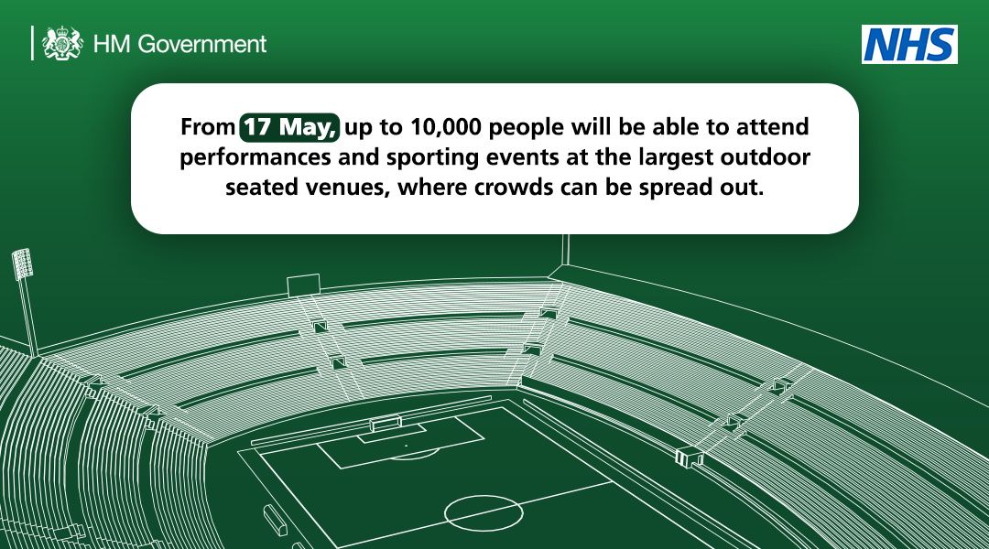
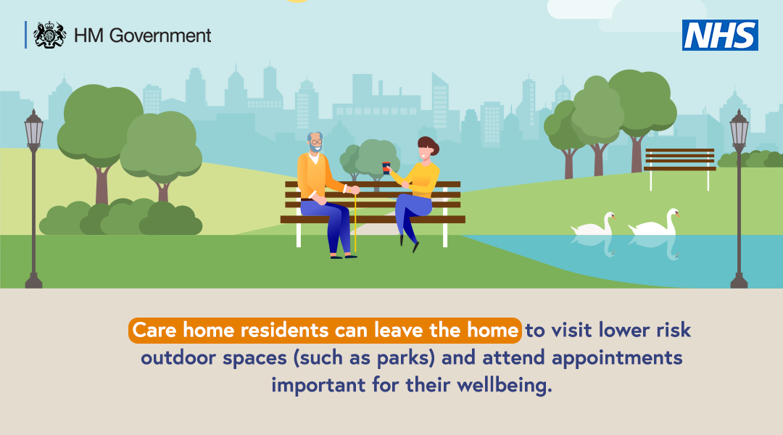
COVID-19 Stakeholder and Influencer Toolkit
Overview
On Monday, step 3 of the Roadmap out of COVID-19 restrictions came into force. This now means that you can meet people indoors.
We must, however, take the next step back to a more normal life carefully and be mindful to stick to the Hands, Face, Space, Fresh Air advice.
The guidance on meeting and greeting friends and family moves forward to place an emphasis on personal responsibility. Use common sense when greeting others to ensure we continue to protect the people most vulnerable against the impact of COVID-19. We must all exercise caution as we move forward through the roadmap out of lockdown.
Key messages
We are now in step 3 of the Roadmap. Indoor hospitality is now open, including cinemas and theatres.
The COVID-19 vaccine is now available to over 34’s.
New guidance on meeting and greeting friends and family means you will be able to hug people again. Read this article on ‘5 ways to make hugging safer’.
COVID-19 Influencer Toolkit - updated 18 May 2021 Document owned by National Resilience Hub External Affairs Team

Slide 2
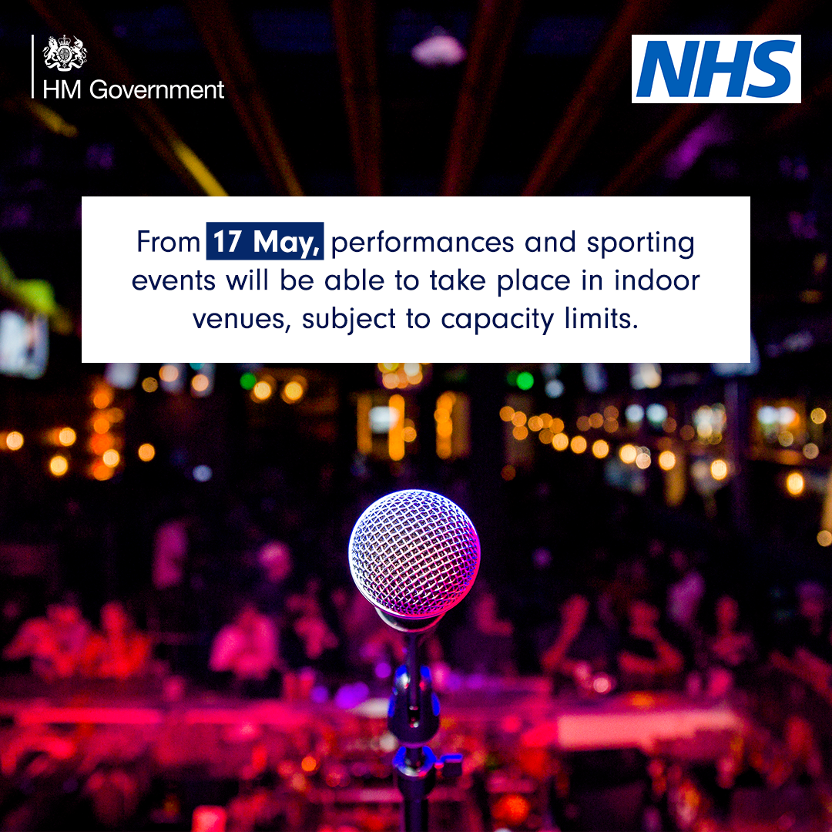
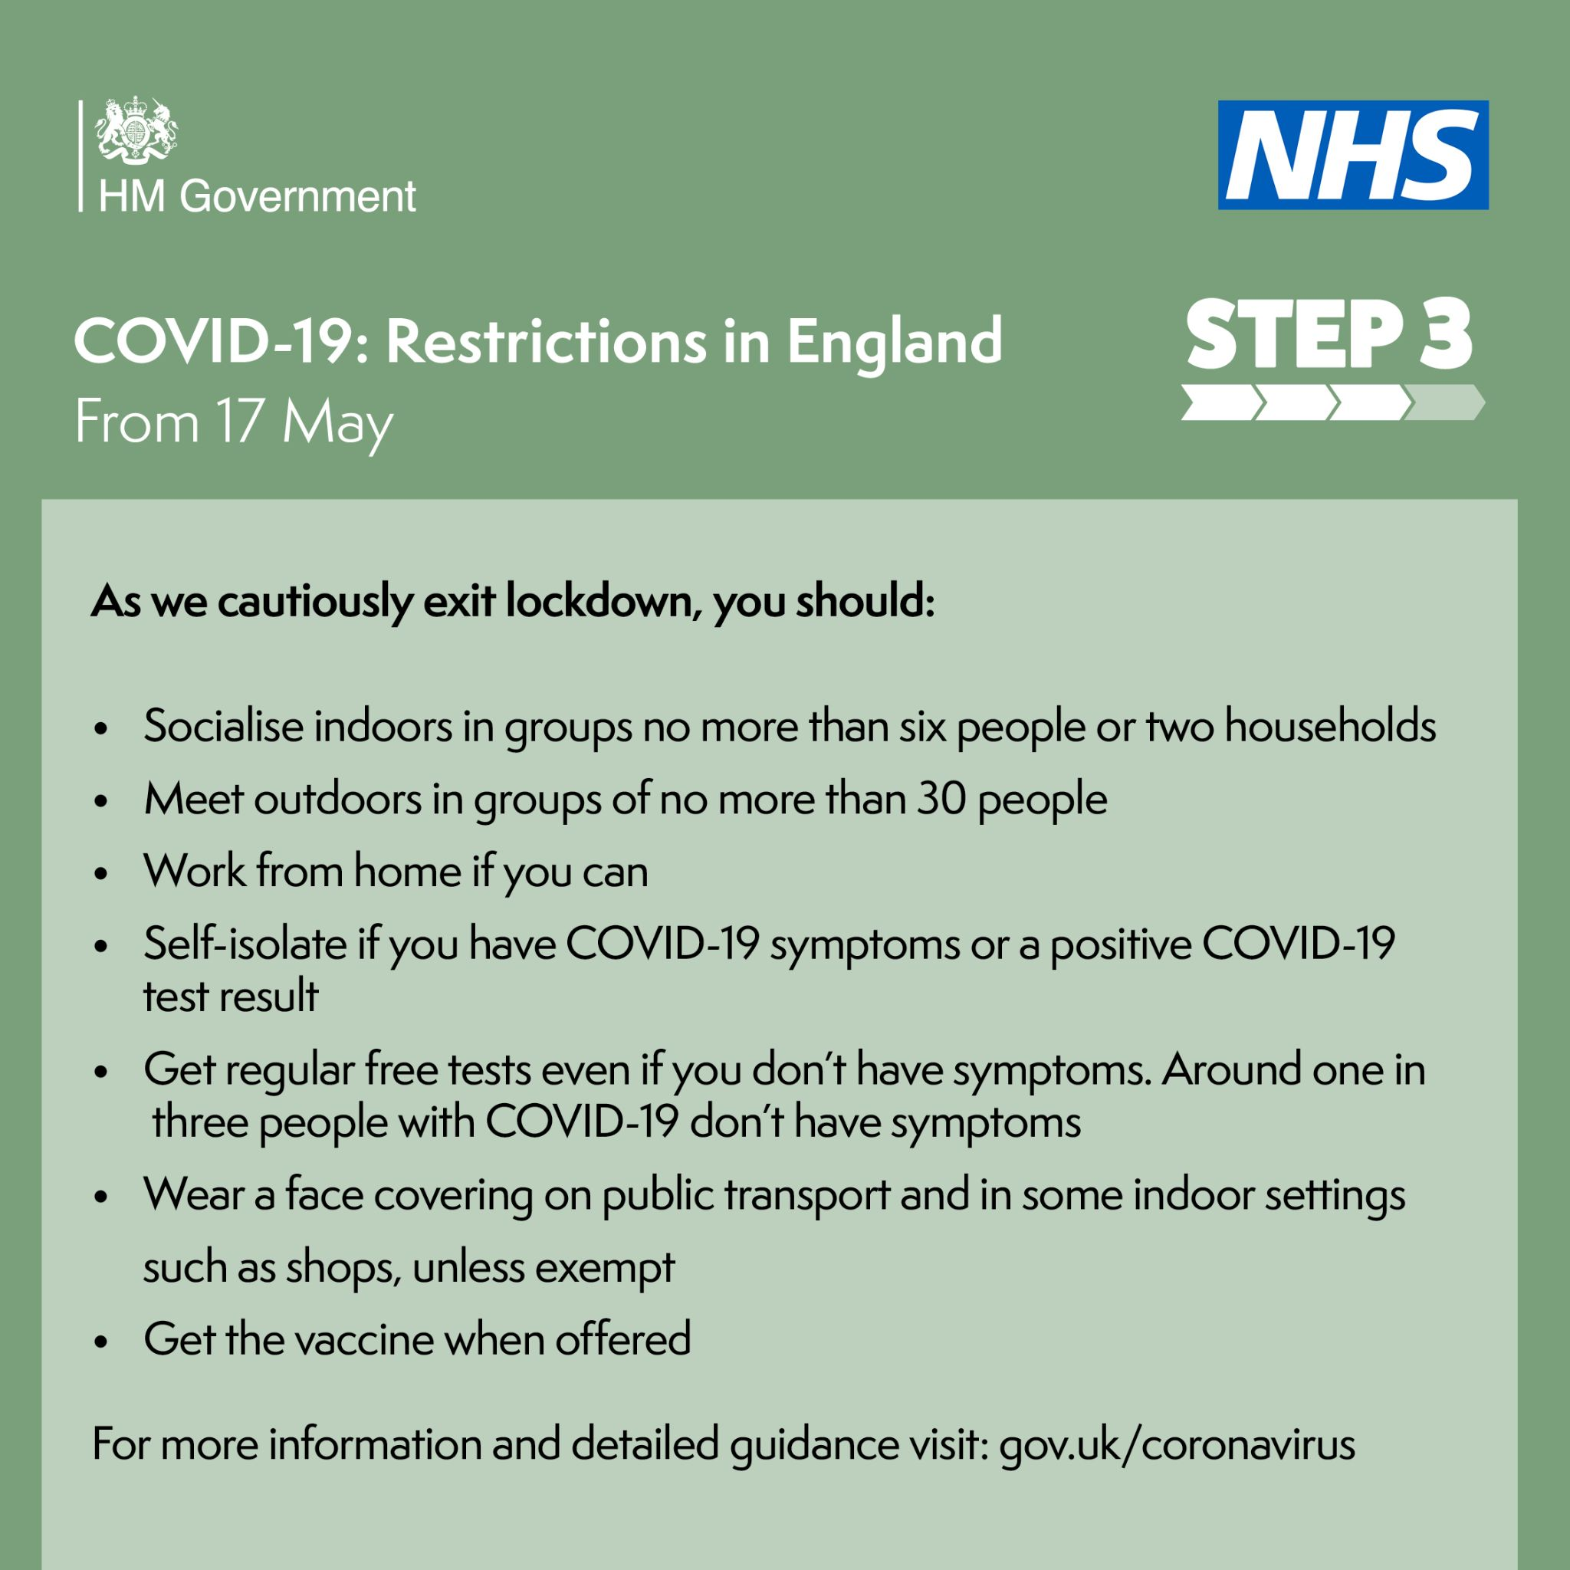
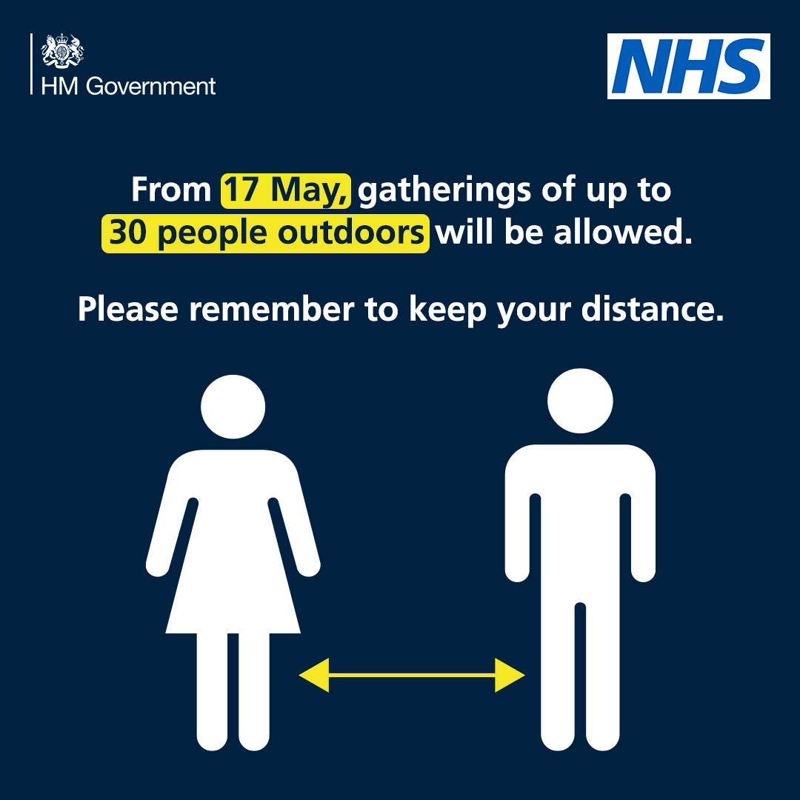
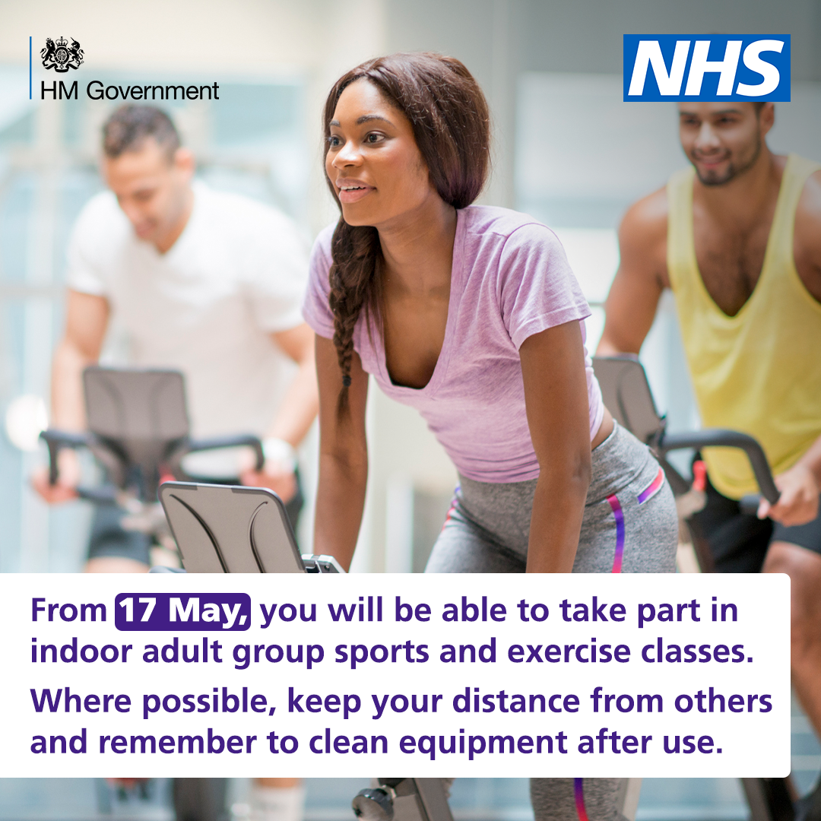
COVID-19 Stakeholder and Influencer Toolkit
Roadmap
Since Monday, you are now able to meet other people inside in social situations. Indoor gatherings are limited to six people, or two households. Each household can include a support bubble, if eligible. Outdoor social gatherings will be limited to 30 people.
Hospitality venues, such as restaurants, pubs, theatres and cinemas have reopened to indoor activities. People can now attend indoor and outdoor events, including live performances, sporting events and business events. All business reopenings must operate in accordance with COVID-19 secure guidelines
How you can help
Post this Tweet to your networks setting out the Roadmap changes since Monday.
Post assets from the Coronavirus Resource Centre on your social media.
COVID-19 Influencer Toolkit - updated 18 May 2021 Document owned by National Resilience Hub External Affairs Team

Slide 3
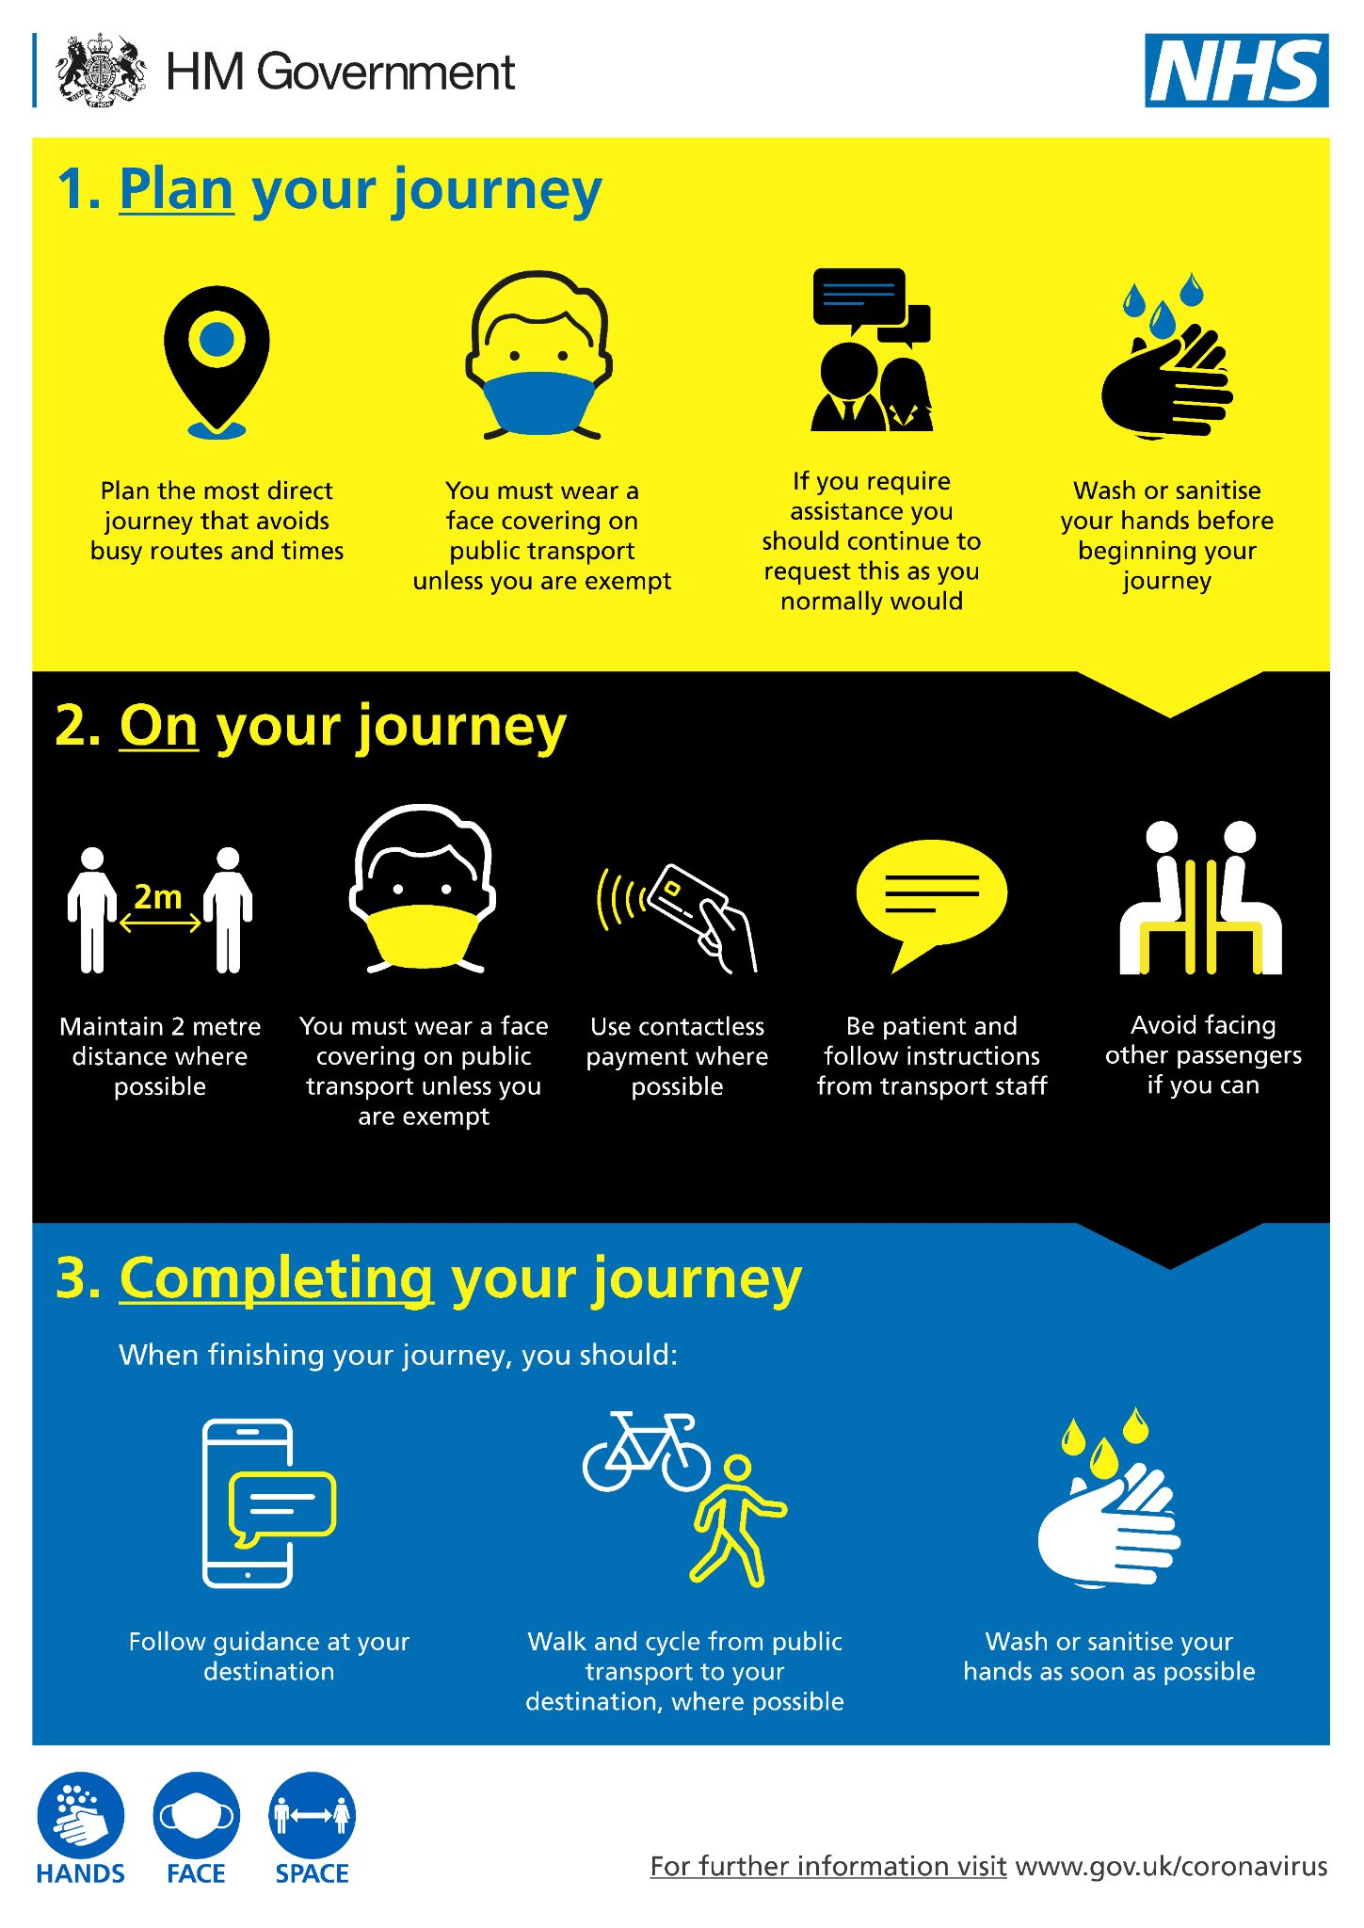
COVID-19 Stakeholder and Influencer Toolkit
Travel
From Monday, the travel advice has changed. Check before you travel. Plan ahead. Travel safely.
As restrictions ease, transport services and roads are likely to be busier so please plan ahead.
When using public transport, you should regularly sanitise your hands, wear a face covering unless you are exempt, and keep your distance where possible.
On your journey, where possible, open a window to increase ventilation.
There will no longer be a legal restriction or permitted reason required to travel internationally. There will be a traffic light system for international travel.
How you can help
Direct your networks to guidance on how to travel safely
Post the assets on your social media and use in your communications
Post a link to international travel guidance on your channels
COVID-19 Influencer Toolkit - updated 18 May 2021 Document owned by National Resilience Hub External Affairs Team

Slide 4
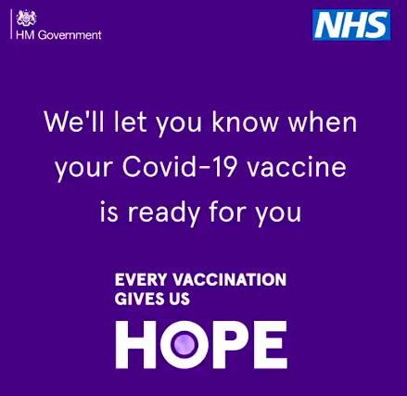
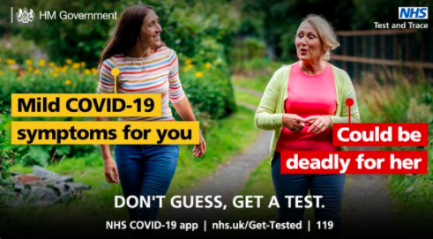
COVID-19 Stakeholder and Influencer Toolkit
Variants of Concern
Be careful: a new COVID-19 variant is spreading in some parts of England. The areas in which the new COVID-19 variant is spreading fastest are Bolton, Blackburn and Darwen.
Given the increased risk of transmitting COVID-19, you should take particular caution when meeting anyone outside your household or support bubble. This will keep yourself and others safe. In particular, wherever possible, you should try to:
Meet outside rather than inside where possible
Try to keep 2 metres apart from people that you don’t live with (unless you have formed a support bubble with them), this includes friends and family you don’t live with
Get tested twice a week for free and isolate if you are positive
Continue to work from home if you can
Get vaccinated when you are offered it, and encourage others to do so as well
How you can help
Guide your stakeholders in these areas to the guidance around Variants of Concern.
Share assets on the Variants of Concern with your networks to ensure people in these areas are aware of the rules and what they need to do.
COVID-19 Influencer Toolkit - updated 18 May 2021 Document owned by National Resilience Hub External Affairs Team

Slide 5
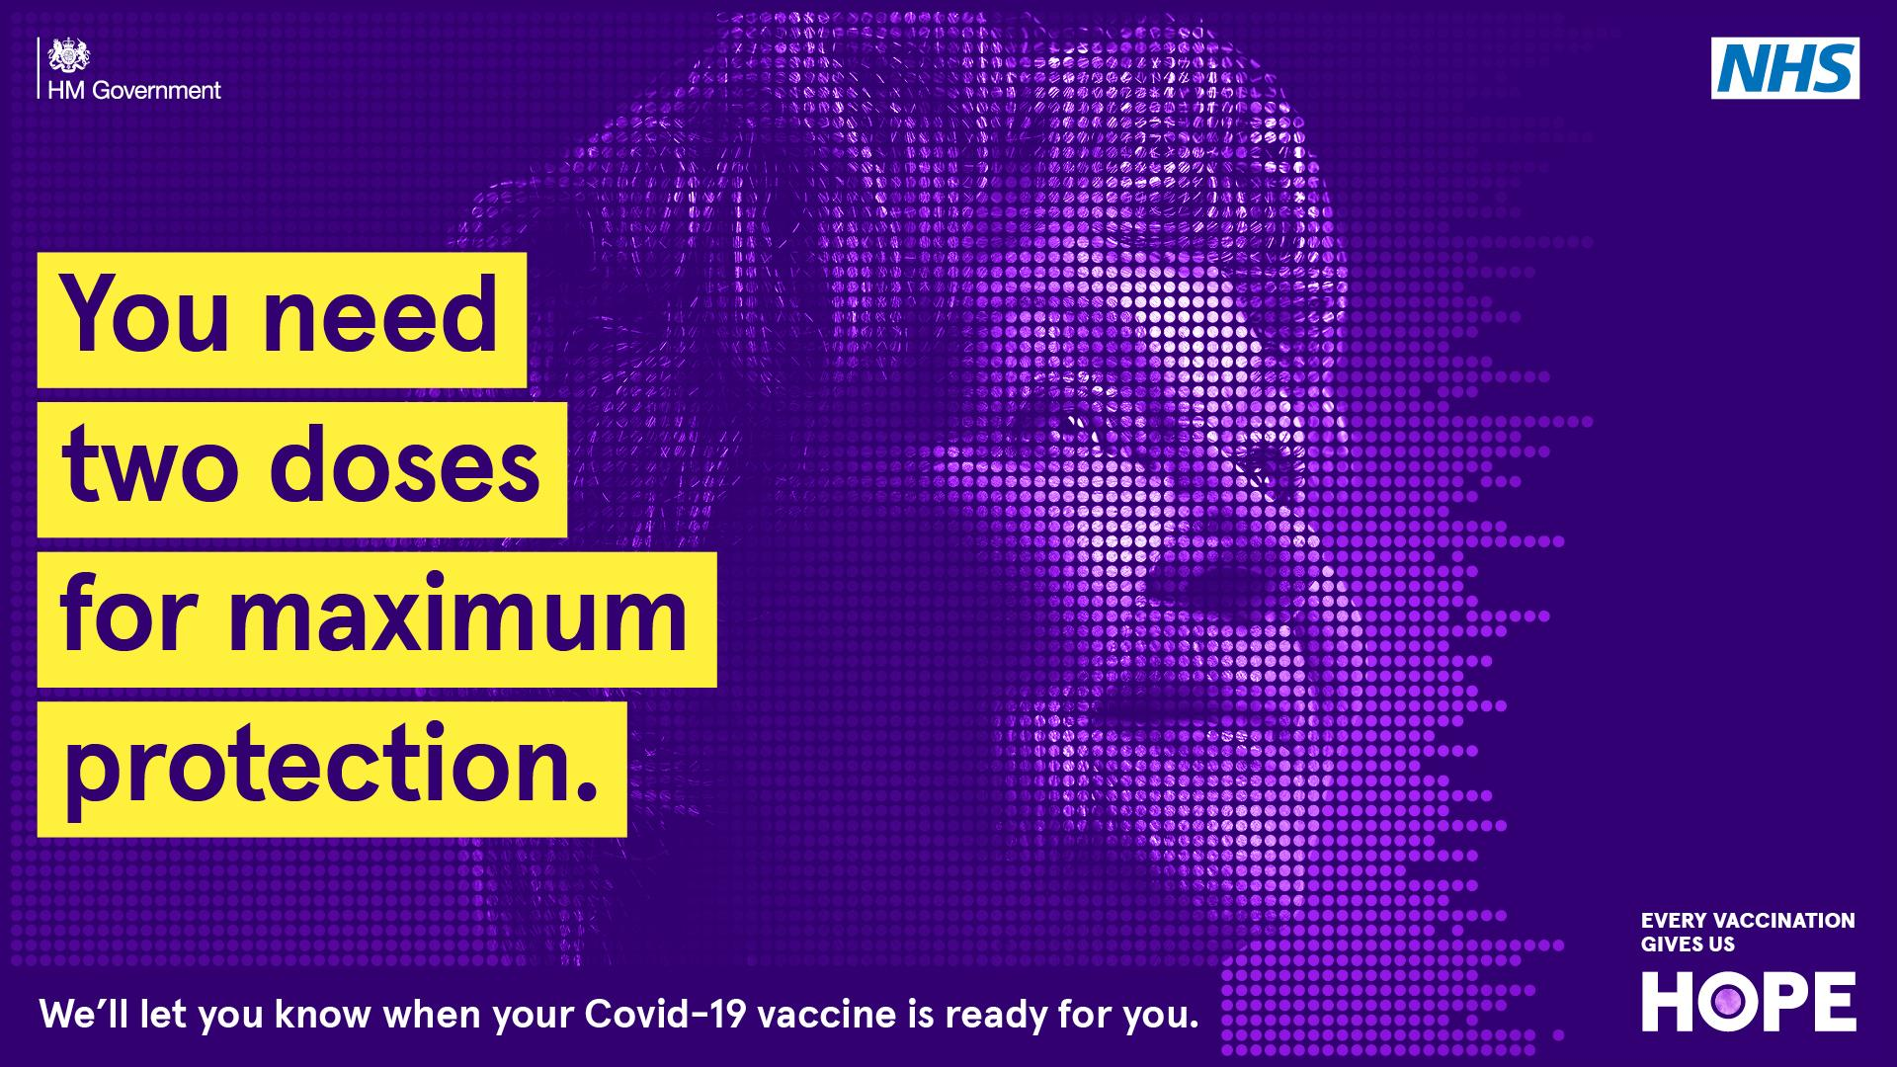
COVID-19 Stakeholder and Influencer Toolkit
Vaccines
More than 36.5 million people have had their first dose of the vaccine and we have reached a great milestone of more than 20 million people being fully vaccinated.
Last Friday, the Government announced that second dose appointments will be brought forward from 12 weeks to 8 for people aged 50+ who have not had theirs yet. The NHS will contact you if your appointment needs to be moved.
You must follow the rules after you’ve had the COVID-19 vaccination. Remember: Wash your hands. Cover your face. Keep your distance.
How you can help
Let your networks know that people aged 34 or over, or people who turn 34 before 1 July 2021, can now book their COVID-19 vaccine. Post this NHS tweet with the details.
Post videos via this link to trusted community leaders to help tackle the spread of false information about the COVID-19 vaccine.
Share videos in community languages on vaccine disinformation, with your networks.
COVID-19 Influencer Toolkit - updated 18 May 2021 Document owned by National Resilience Hub External Affairs Team

Slide 6
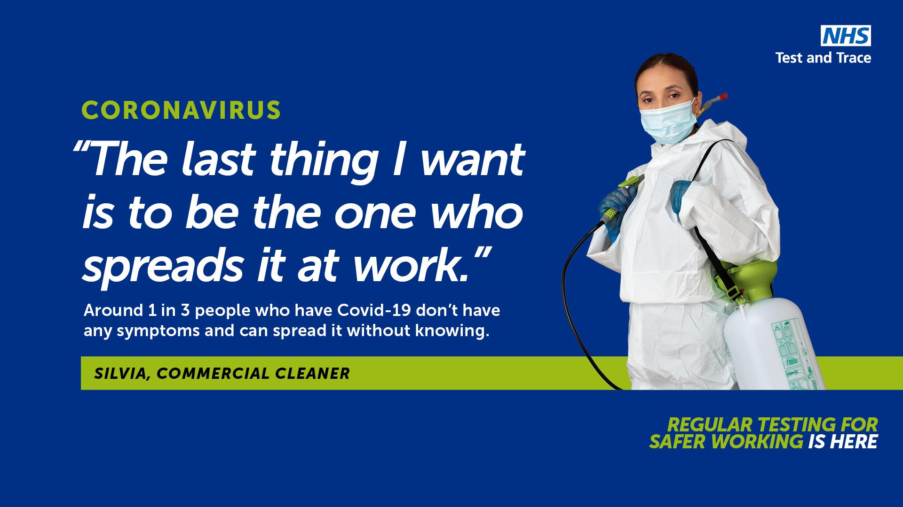
COVID-19 Stakeholder and Influencer Toolkit
Testing
Why is it important to get tested, even if there is a vaccine?
One in three people who catch the COVID-19 virus will not show any symptoms at all. It is important we keep testing to protect ourselves and the people we love.
Everyone is encouraged to take a free rapid lateral flow test twice a week to avoid a further lockdown.
Routine testing is also important to detect new variants.
If your lateral flow test comes back positive, you must take a PCR test as they detect which variant it is. This will help in containing variants of concern.
How you can help
Tell your networks everyone can get free, rapid lateral flow tests twice a week.
Tell your networks that they can book a rapid test by calling 119, using the NHS COVID-19 app or via the booking page on the NHS website.
Use these images in different languages to let your networks know about testing.
COVID-19 Influencer Toolkit - updated 18 May 2021 Document owned by National Resilience Hub External Affairs Team

