Slide 1
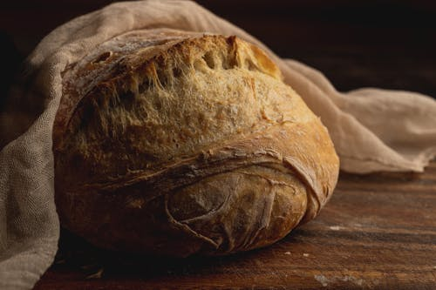
Federation of Bakers – Market Overview
Kantar Data 52 w/e to 17th March 2024
Roman Brophy

Slide 2
Spend on Bread and Morning Goods has experienced strong double-digit growth over the last two years. Despite this Volume has remained relatively stable highlighting the impacts of inflationary pressures within category
Bread & Morning Goods – Total Spend (£000) and Packs (000)
+10.5%
+12.8%
+1.1%
-1.3%
Source: Kantar Worldpanel | Total Bread and Morning Goods | 52 w/e 17th March 24, 19th March 23 and 20th March 22
2
Notes:
2

Slide 3




All Bread sectors experience strong Spend growth, however Specialty Bread is the standout performer due it seeing the highest Volume growth (+4.3%) and Spend growth (+14.1%)
Bread & Morning Goods – Total Spend (£000) and Packs (000) by Segment
Traditional Ambient Bread
£2.2bn
+8%
1.7bn
-0.7%
£1.4bn
+13.9%
Morning & Snack Bakery
1.2bn
+2.6%
£1bn
+14.1%
Speciality Bread
+4.3%
860mn
Traditional Rolls
£1bn
+8%
-0.2%
980mn
Source: Kantar Worldpanel | Total Bread and Morning Goods | 52 w/e 17th March 2024
3
Notes:
3

Slide 4


Both Pre-packed and ISB experience double-digit growth over the last two years, although ISB appears to be driving Volume growth. This could be driven by the slower increase in the Price per Pack (+8.9% vs +9.8%)
Bread & Morning Goods – Pre-Pack vs In Store Bakery (ISB)
Pre-packed
ISB
Pre-packed
ISB
Source: Kantar Worldpanel | Total Bread and Morning Goods | 52 w/e 17th March 24 and 19th March 23 & 20th March 22
4
Notes:
4

Slide 5
Both Pre-Packed and ISB experience growth over the last two years, although ISB is the driver of Volume growth. This is despite ISBs Price Per Pack increasing at a faster rate both YoY and 2YoY, +5 and +11 ppts, respectively.
Traditional Ambient Bread | Pre-Pack vs In Store Bakery (ISB)
+6.1%
-3.3%
-1.4%
+11.5%
1.5bn
1.5bn
1.5bn
£1.5bn
£1.7bn
£1.8bn
+17.4%
+21.6%
+1.8%
+4.1%
£278m
£338m
£397m
219m
223m
232m
Pre-packed
ISB
Pre-packed
ISB
Source: Kantar Worldpanel | Traditional Ambient Bread | 52 w/e 17th March 24 and 19th March 23 & 20th March 22
5
Notes:
5

Slide 6

ISB is gaining Spend Share in all Bread sectors other than Morning & Snack Bakery and Speciality Bread
Bread & Morning Goods – % Spend Share by Pre-Pack / ISB by Sector
Pre-Packed
ISB
Total Bread & Morning Goods
Traditional Ambient Bread
Morning & Snack Bakery
Speciality Bread
Traditional Rolls
83.3 : 16.7
81.8 : 18.2
87.8 : 12.2
90.6 : 9.4
72.9 : 27.1
+0.3
+1.4
-0.4
-0.5
+0.2
ISB Percentage Point Share Change
Source: Kantar Worldpanel | Total Bread and Morning Goods Segemnts | 52 w/e 17th March 24
6
Notes:
6

Slide 7
Over the last two years the average Private Label Price per Pack has been 23p lower compared to its Branded competitors. Resulting in Private Label continuously increasing their Spend and Volume (Pack) Share.
Traditional Ambient Bread | Pre-Pack | Spend & Volume by Branded & Private Label
Source: Kantar Worldpanel | Traditional Ambient Bread | Branded vs Private Label | 52 w/e 17th March 24, 19th March 23 and 20th March 22
7
Notes:
7

Slide 8
Despite inflationary pressures causing both Branded and Private Label Pre-packed price increases, the gap between the two remains relatively flat between 0.21p and 0.25p
Traditional Ambient Bread | Pre-Pack | Branded & Private Label Price Per Pack
23
24
Source: Kantar Worldpanel | Traditional Ambient Bread | Average Price Per Pack | Rolling 52 w/e 17th March 24
8
Notes:
8

Slide 9
Within the Ambient Bread segment White bread is the only type increasing its Spend Share as it continues to attract more Shoppers. Brown and Grained are both more expensive per pack, which may have an impact on their Shares
Ambient Bread % Spend and Shopper Change
Source: Kantar Worldpanel | Traditional Ambient Bread | 52 w/e 17th March 24, 19th March 2023 and 20th March 2022
9
Notes:
9

Slide 10
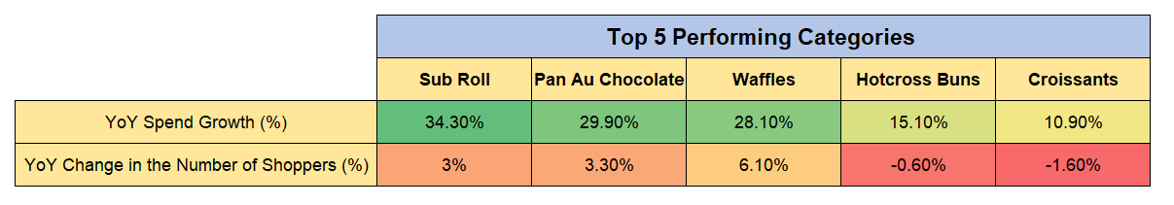
The Sub Roll category is the clear stand out performer within Total Bread & Morning Goods with strong double-digit growth
Bread & Morning Goods - %Spend Growth & Shopper Change vs LY – Top 5 Categories
1
2
The strong double-digit Sub Roll growth has been derived from Frequency growth (+11.4%) and the increased Price per Pack (+24.3%).
Aldi and M&S have been stand out performers within the Sub Roll category as they have experienced +88.1% and +26.2% Spend growth, respectively.
As consumers continue to make simpler meal choices and see value in the volume promotions the Total Bread & Morning Goods market will continue to benefit from increased Spend.
1
2
Source: Kantar Worldpanel | Total Bread and Morning Goods | 52 w/e 17th March 43 vs LY
10

Slide 11
Private Label holds over 50% Spend Share in Total Bread & Morning Goods and all Bread segments apart from Traditional Ambient Bread
Bread & Morning Goods - % Branded / Private Label Spend by Sector
Source: Kantar Worldpanel | Total Bread and Morning Goods Segments| 52 w/e 17th March 24
11
Notes:
11

Slide 12
A similar picture is evident when looking at Volume (Pack) Share as Private Label holds over 50% share across Total Bread & Morning Goods and all its Bread segments
Bread & Morning Goods - % Branded / Private Label Volume (Packs) by Sector
Chart Footnote
Source: Kantar Worldpanel | Total Bread and Morning Goods Segments | 52 w/e 17th March 24
12
Notes:
Key Points: A similar picture has been painted when look at Volume Pack share as Private Label holds over 50% share across Total bread and all categories….
12

Slide 13
Pre-packed is more varied in terms of Bread types, whereas ISB is dominated by White bread (88% Share)
Ambient Bread % Volume by Bread Type
Source: Kantar Worldpanel | Total Bread and Morning Goods | Pre-Pack and ISB Volume (Pack) Share (%) | 52 w/e 17th March 24, 19th March 2023 and 20th March 2022
13

Slide 14
Since Covid restrictions eased Penetration growth began to slow and even began contributing to decline during Oct 22 – Sep 23. However, Penetration has since improved, most recently contributing +£1.5m this period
Total Bread and Morning Goods | Sourdough Bread | Rolling 12 w/e Measure Tree | 12 w/e 17th March 2024
Covid
21
22
23
24
Source: Kantar Worldpanel | Total Bread and Morning Goods | Sourdough Bread | Rolling 12 w/e 17th March 2024
14
Notes:
14

Slide 15


Private Label expands its Sourdough Spend Share by +1.8 ppts
Total Bread and Morning Goods | Sourdough Bread | Branded vs Private Label Spend Share (%) | 12 w/e 17th March 2024 vs LY
Branded
Private Label
Spend Share: 37.2%
Spend Share: 62.8%
-1.8 ppts
+1.8 ppts
Source: Kantar Worldpanel | Total Bread and Morning Goods | Sourdough Bread | Branded vs Private Label Spend Share (%) | 52 w/e 17th March 2024 vs LY
15

Slide 16


Tesco continue to hold the largest Spend Share despite the Traditional Big Four all experiencing Spend Share declines YoY
Total Bread and Morning Goods | Retailer Spend Share (%) | 52 w/e 17th March 2024, 19th March 2023 and 20th March 2022
In-Store Bakery: 17.6%
Source: Kantar Worldpanel | Total Bread and Morning Goods | Retailer Spend Share (%) | 52 w/e 17th March 2024, 19th March 2023 and 20th March 2022

Slide 17


Thank you
Roman Brophy
Roman.Brophy@kantar.com
Kantar | Westgate | London | W5 1UA | www.kantar.com
Notes:
17

